Slide 1



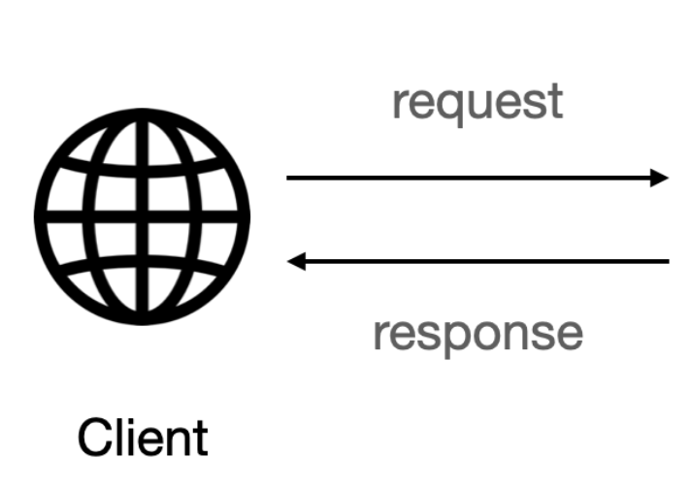




Serves the GET Request
Serves the POST resquet
Serves the PUT resquet
Serves the DELETE resquet

